Slide 1

Machine Learning
Madiha Hameed Awan

Slide 2
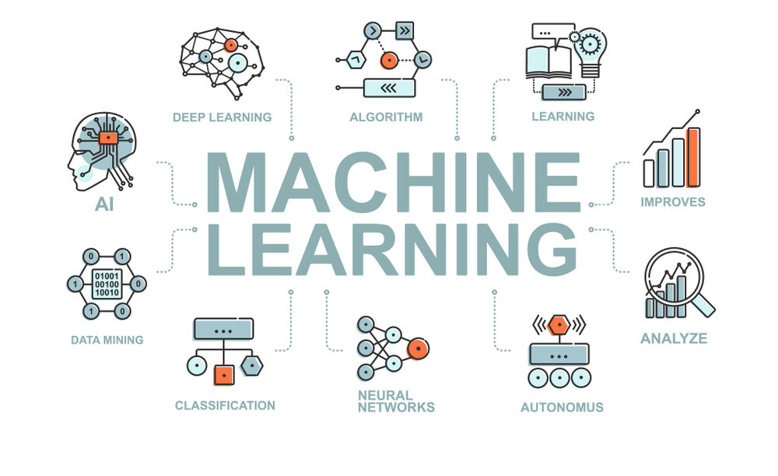
Introduction

Slide 3
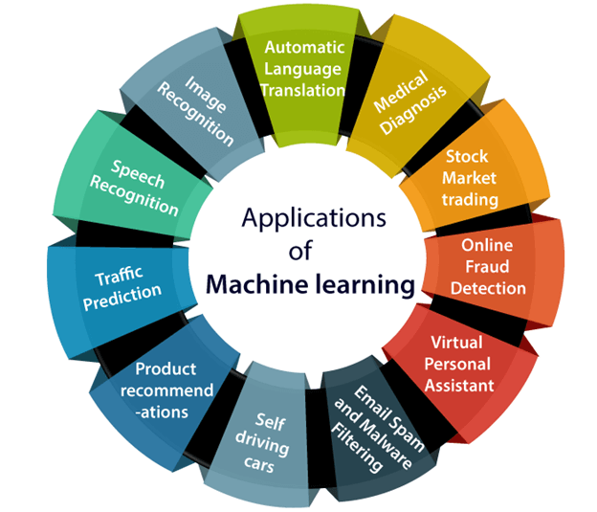
Application of ML

Slide 4
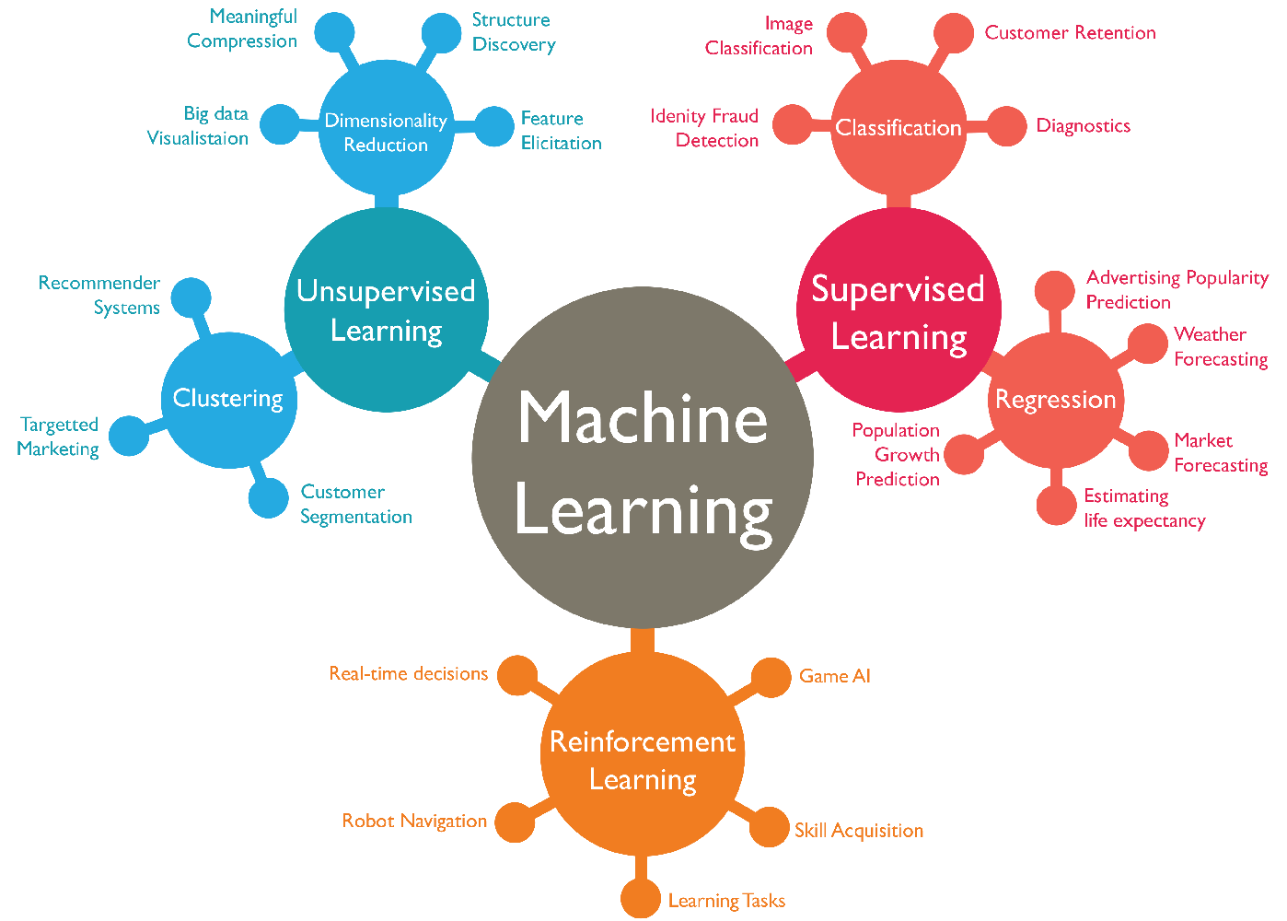
Types of ML

Slide 5
1) Supervised Learning
In supervised learning, the algorithm is trained on a labeled dataset, where each input is associated with a corresponding target or output. The goal is to learn a mapping from inputs to outputs so that the model can make predictions on new, unseen data. Common tasks include classification (assigning labels to inputs) and regression (predicting numerical values).
2) Unsupervised Learning
Unsupervised learning deals with unlabeled data, where the algorithm aims to discover patterns, structures, or relationships within the data. Common techniques include clustering (grouping similar data points) and dimensionality reduction (reducing the number of features while preserving important information).
3) Semi-Supervised Learning
Semi-supervised learning combines elements of both supervised and unsupervised learning. It typically starts with a small amount of labeled data and a larger pool of unlabeled data. The algorithm learns from the labeled data and leverages this knowledge to make inferences about the unlabeled data.
4) Reinforcement Learning
Reinforcement learning involves an agent that interacts with an environment and learns to make a sequence of decisions (actions) to maximize a cumulative reward. It's commonly used in applications like game playing, robotics, and autonomous systems

Slide 6
5) Deep Learning
Deep learning is a subfield of machine learning that focuses on artificial neural networks (ANNs) with multiple layers (deep networks). It has been highly successful in tasks such as image and speech recognition, natural language processing, and autonomous driving.
6) Transfer Learning
Transfer learning involves using a pre-trained model on one task and fine-tuning it for a related task. This approach can save time and resources when building models for new tasks.
7) Online Learning
Online learning, or incremental learning, updates the model continuously as new data becomes available. It's well-suited for applications where the data stream is continuous, such as fraud detection or recommendation systems.
8) Ensemble Learning:
Ensemble learning combines multiple machine learning models to improve overall predictive performance. Common techniques include bagging (e.g., random forests) and boosting (e.g., AdaBoost and Gradient Boosting).

Slide 7
9) Anomaly Detection:
Anomaly detection focuses on identifying rare or unusual instances in a dataset. It's widely used in fraud detection, network security, and quality control.
10) Explainable AI (XAI):
Explainable AI aims to make machine learning models more interpretable and understandable to humans. This is crucial for applications where transparency and trust are essential.
Summery
These are some of the fundamental types of machine learning, and many machine learning problems can be categorized into one or more of these types, depending on the nature of the data and the desired outcome.

Slide 8
Questions?
End of Lecture 1

